Slide 1


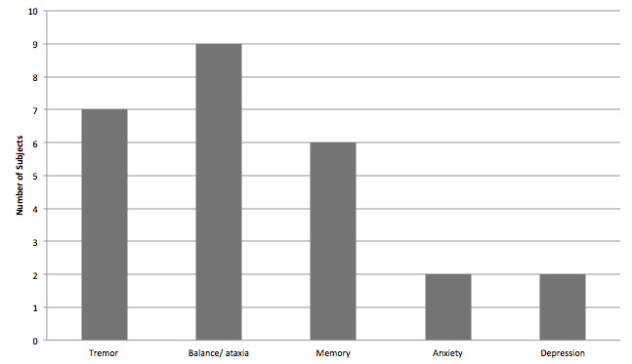
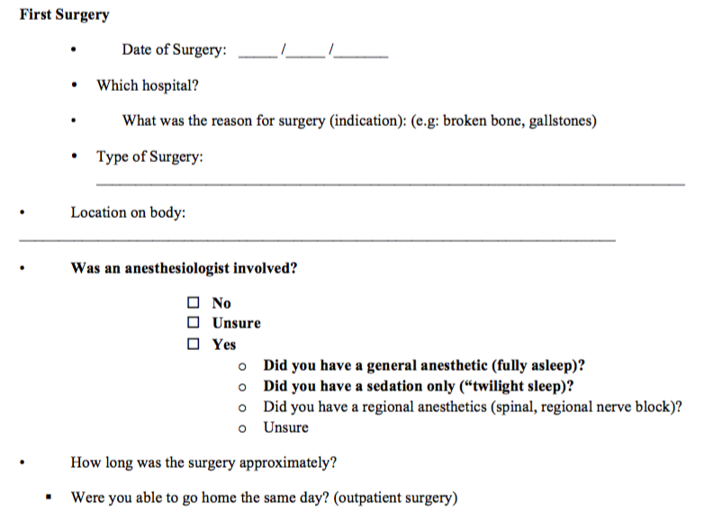
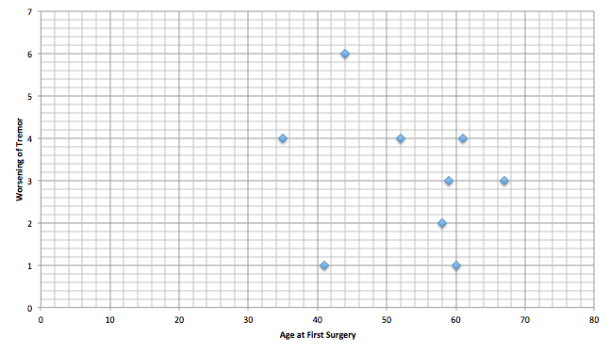
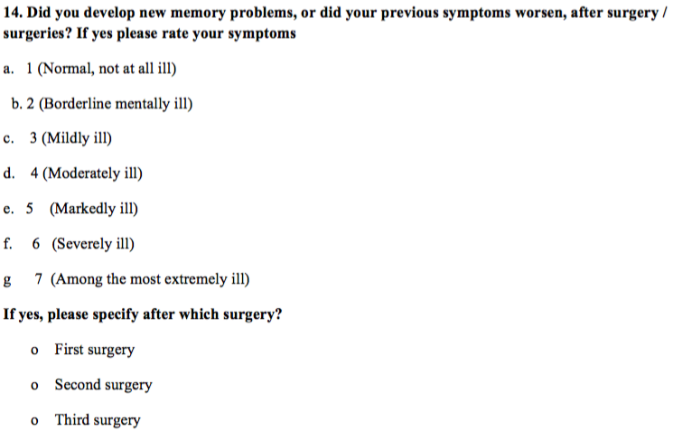
General Anesthetic Use in Patients with the Fragile X Premutation
Andrew Ligsay BS, Marwa El-Deeb MD, Nina Schloemerkemper MD, Jeremy Grayson MD, Randi Hagerman MD
1. Medical Investigation of Neurodevelopmental Disorders, University of California Davis Medical Center, 2. University of California Davis School of Medicine, 3. Department of Pediatrics, University of California Davis Medical Center,
4. Department of Anesthesiology and Pain Medicine, University of California Davis Medical Center, 5. Department of Anesthesia, Rutgers University Robert Wood Johnson Medical School
Specific Aims
Materials and Methods
Results
Conclusions
Aim 1: Develop a novel survey that captures neurological, cognitive, and behavioral changes in patients with the fragile X premutation who have undergone surgical procedures requiring general anesthesia.
Aim 2: Collect preliminary data to validate survey.
Aim 3: Identify specific symptoms that have a tendency to develop more frequently or soon after general anesthesia.
Participants were identified through the MIND Institute Subject Tracking System (STS).
Inclusion criteria:
Adults ages 50 – 90 years old
Documentation of fragile X premutation
History of surgery requiring general anesthesia
Consent to participate in research study
Exclusion criteria:
History of stroke, cerebrovascular incident, or irreversible CNS injury
Targeted survey was developed focusing on the type of surgical procedure, if general anesthesia was used, as well as symptoms including tremor, balance, memory deficits, anxiety, and depression (figure 1).
Figure 1. Example questions from survey requesting type of surgical procedure (top) and sequelae following their procedure (bottom).
Total of 39 participants returned the survey:
Males (n = 11), females (n = 28)
Average age at first surgery:
Males = 52.57 yo, females = 66.25 yo
Of these participants, 17 (44%) reported worsening of at least 1 symptom within one year of surgery. The most common reported symptom was worsening balance/ataxia (n = 9; 23%), followed by memory problems (n = 7; 18%) and tremor (n = 6; 15%). See figure 2.
Figure 2. Distribution of reported symptoms.
Second, there was no clear correlation between age of surgery and degree to which symptoms worsened. See figure 3.
Figure 3. Example scatterplot comparing age at surgery vs worsening of tremor within 1 year. R = -0.24. No other symptoms showed correlation.
Four patients underwent multiple surgical procedures requiring general anesthesia. Each reported worsening of at least one symptom after each exposure.
Manuscript reviewing published case reports is pending:
Ligsay A, El-Deeb M, Schloemerkemper N, Grayson J,
and Hagerman R. “General Anesthetic Use in Fragile
X Spectrum Disorders.” In prep.
New Data:
Greater than 40% reported new or worsening symptoms within one year from their procedure.
A small subset with multiple procedures experienced neurocognitive decline following each exposure.
Survey:
Needs alterations – Some answers and responses were too broad (e.g. difficult to categorize type of surgical procedure)
Background
Fragile X syndrome (FXS) is the most common single gene cause of intellectual disability, and is characterized by a CGG repeat expansion mutation of >200 repeats in the FMR1 gene. The fragile X premutation, however, is characterized by 55 – 200 CGG repeats. Many of these patients undergo normal development, but a subset may develop a neurodegenerative disorder after age 60, which presents as tremors, ataxia, and progressive neurological deficits.
Numerous case reports suggest that some patients with the premutation are particularly susceptible to drugs and environmental toxins leading to an even earlier onset of motor and neurological problems. Of these reports, a handful suggest some general anesthetics may serve as the toxic insult to premutation carriers that accelerates their symptomatology of tremors, ataxia, and cognitive decline. To date, there have been no formal studies regarding short and long-term sequelae following general anesthetic use in this particular population.
The purpose of this research project was to formulate a survey aimed to study specific neurological, cognitive, and behavioral changes that may occur in patients with the fragile X premutation who have undergone surgical procedures requiring general anesthesia. Specifically, we were looking to study symptoms that may have occurred within a 1 year period following their exposure. We hypothesized that many of these patients will report evidence of motor and/or neurologic decline.
Selected References
Grigsby et al (2014). “The cognitive neuropsychological phenotype of carriers of the FMR1 premutation.” J Neurodev Disord. 6(1): 28.
Hagerman and Hagerman (2015). “The fragile X-associated tremor/ataxia syndrome.” Annals of the New York Academy of Sciences. 1338:58-70
Jacquemont et al (2014). “A higher mutational burden in females supports a ‘female protective model’ in neurodevelopmental disorders.” Am J Hum Genet. 94(3): 415-425.
Jalnapurkar et al (2015). “Immune mediated disorders in women with a fragile X expansion and FXTAS.” American Journal of Medical Genetics. Part A. 167A(1): 190-197.
Santa Maria et al (2014). “FXTAS in an unmethylated mosaic male with fragile X syndrome from Chile.” Clinical Genetics. 86(4): 378-382.
Tassone et al (2012). “Neuropathological clinical and molecular pathology in female fragile X premutation carriers with and without FXTAS.” Genes, Brain, and Behavior. 11(5): 577-585.
Acknowledgements and Contact
This work was supported through NICHD [grant HD036071], the National Center for Advancing Translational Sciences, National Institutes of Health [grant UL1 TR000002 and linked award TL1 TR000133]. The content is solely the responsible of the authors and does not necessarily represent the official views of the NIH.
Competing Interest: RH has received support from Novartis, Alcobra, Neuren, and Marinus for studies in fragile X syndrome. She has also consulted with Zynerba and Ovid regarding studies in fragile X syndrome. The other authors report no conflicts.
Contact: Andrew Ligsay (aligsay@ucdavis.edu)

